Slide 1
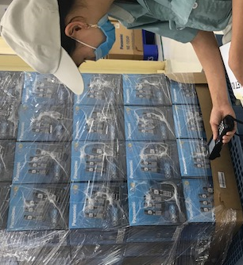
OQC DIGITAL SYSTEM LINK WMS & CONFIRMATION DATA
SCS request:
Visualize status of model following shipment plan daily
Link final confirmation to WMS/PDA for operator working in warehouse
DASHBOARD
LINK WMS/PDA
Option 1
FA
OQC
SCS
WMS
①
Judgement auto email
FA transfer cargo to SCS
Shipment plan
Dashboard
Finish production
Sampling inspection
Shipment plan
*
Option 2
*
①
PSNV Portal
“Control shipping plan”
Pallet ID finish
Warning to dashboard
SCS visualize on pallet
②
Scan ID pallet
Result NG
FA/QC recheck
Judgement OK
Judgement OK
Scan ID pallet to receive
Result judged OK
Confirm data PDA
③
Email auto
Confirm receiving
Auto update
③
WMS
SCS check all data by download
**
Confirm receiving
**
Dashboard
Format check

Slide 2
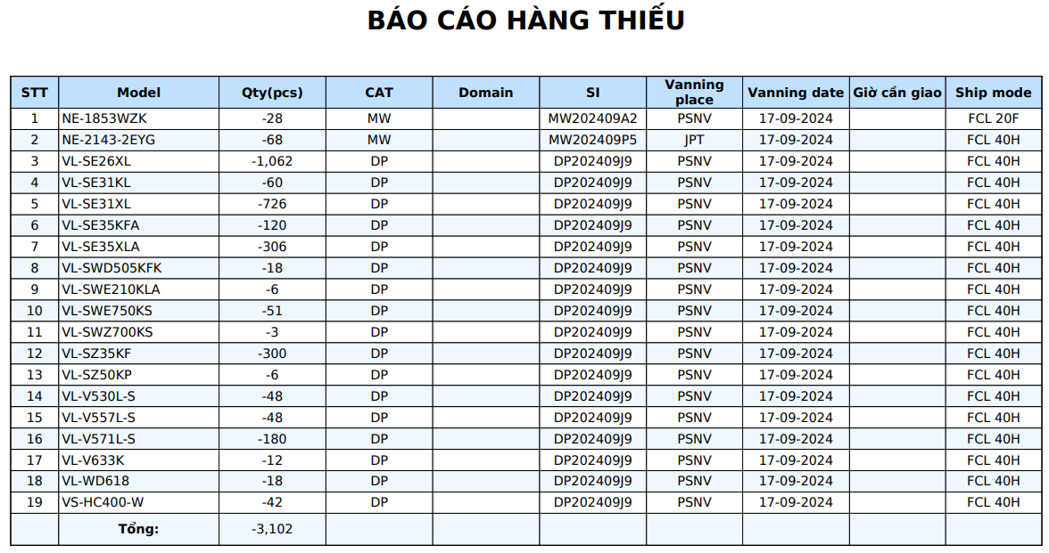
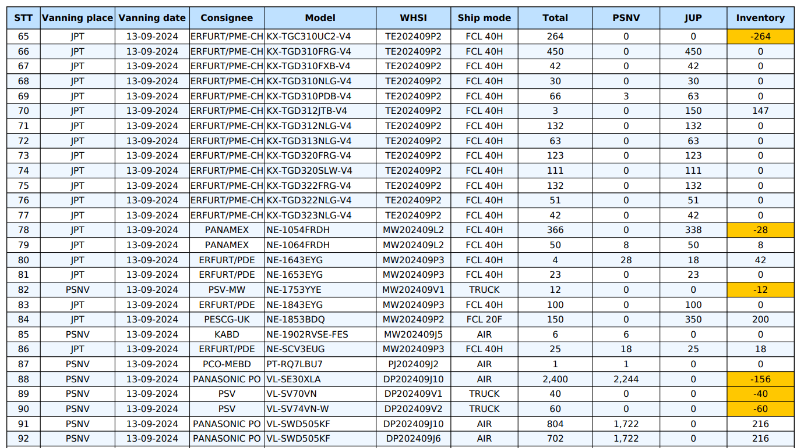
Details shortage shipment plan daily on WMS
Shortage shipment plan daily on WMS
FORMAT DOWNLOAD FROM DASHBOARD

